Slide 1
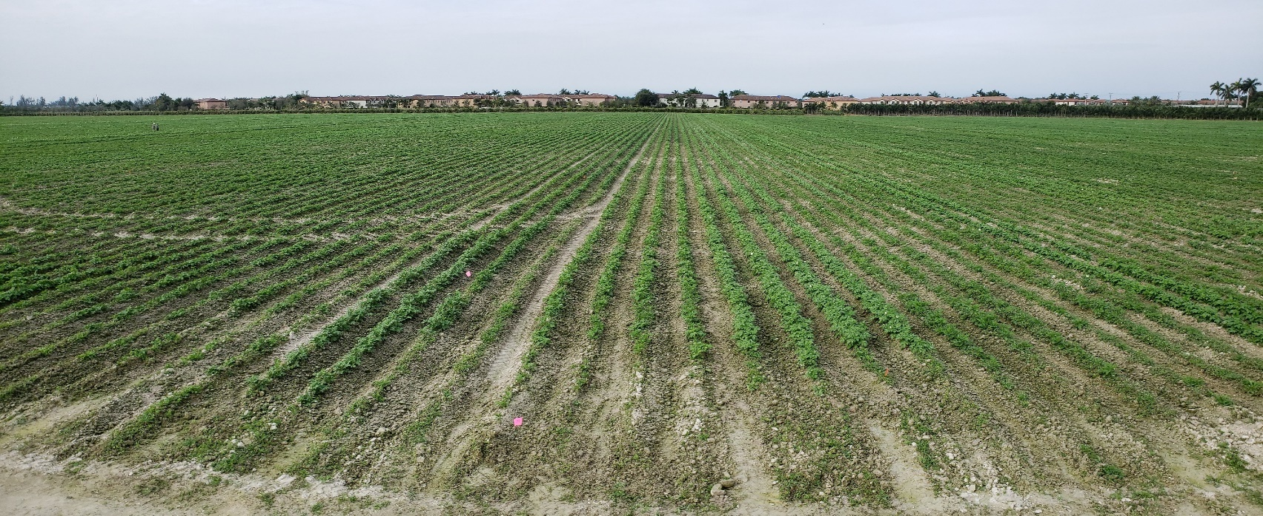

2020 Crop
Winter Test Summary
North Dakota Certified Seed Potatoes
Notes:
Thanks for attending, taking time from your schedule for this meeting.
This presentation is being pre-recorded. If time permits, we can have live discussion at the end.

Slide 2
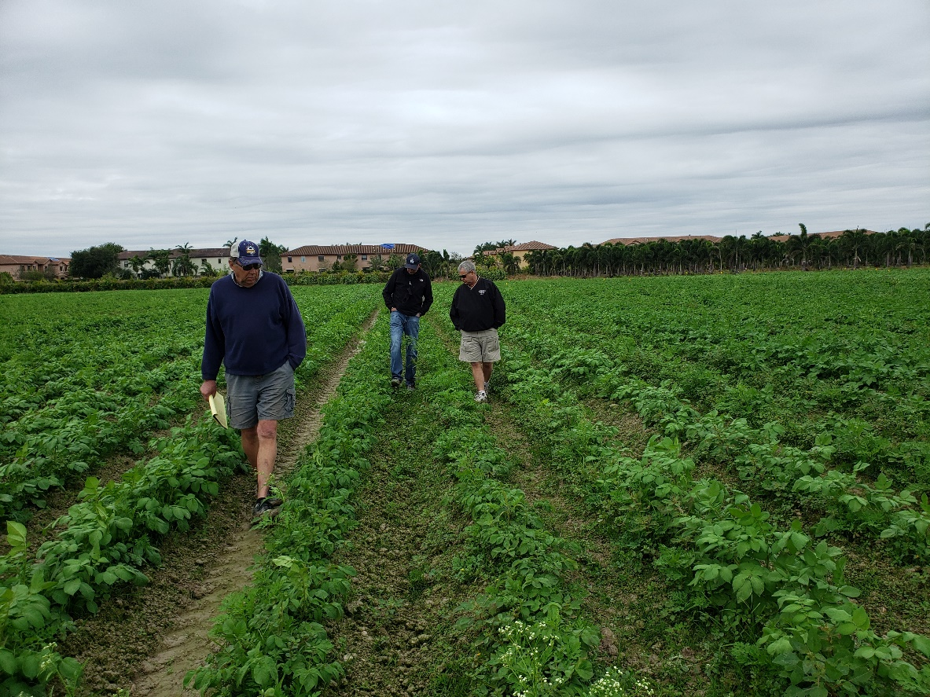
1. Theory of Winter Testing
2. Planting
3. Inspection
4. Data Summary
5. Questions/Discussion
Notes:
The outline is similar to previous Winter Test presentations.

Slide 3

Why?
Industry Standard
Latent Virus Spread
  Mosaics, especially PVY
  PLRV
Cycle of Certification
  End of 2020 Crop
  Transition to 2021 Crop
Re-Certification Eligibility
  Re-certification in ND and other states/provinces
  Certified requirement in other states
Management tool for Grower
Estimate of virus in future crop
Notes:
Most important part of certification process. IMHO
Industry standard – developed and validated over 50 years and 14 certification programs
Focus on virus
Can’t see all virus spread during summer inspections.
Completes starts Cycle, a link from past to future
Management: should want to know, can study results and determine best way to manage and maintain quality in your program.
Provide meaningful results. Best estimate comes from the best sample taken…(next slide, what is the best sample?)
Emphasize Estimate of future crop. And the quality of the estimate depends on…next slide

Slide 4
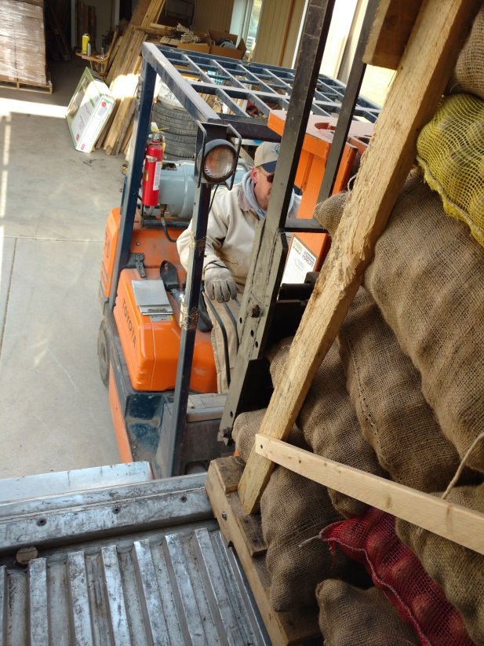
What?
Post Harvest Samples
Random, across entire lot
Golf ball size tubers. 2-3 oz. Larger tubers don’t work!
Quality of sample picked determines quality of Estimate
Careful documentation
Careful handling
Notes:
If not random, result will be skewed. Poor estimate of what is actually in the seed lot.
Results only as good as sample picked.
Large tubers: impractical: sheer size won’t feed this planter properly. We did have several samples with large tubers. The planter plugged on two different occasions. Confuses the mapping/inspection process.
Careful documentation includes accurate tagging. Seed Dept staff checking in. Planting order. Disease testing requirements and requests. Inspection results associated with proper seed lot.
Meticulous and Detailed
Seed Dept staff make every effort to preserve the identity of sample submitted. Positive Lot Identity concept from your farm to your results.

Slide 5
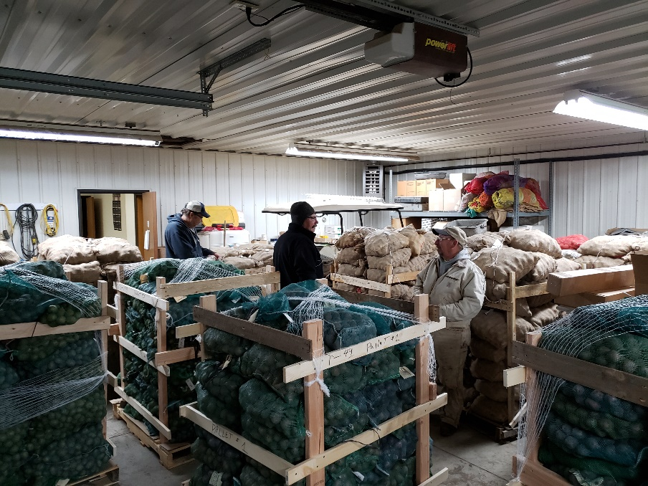
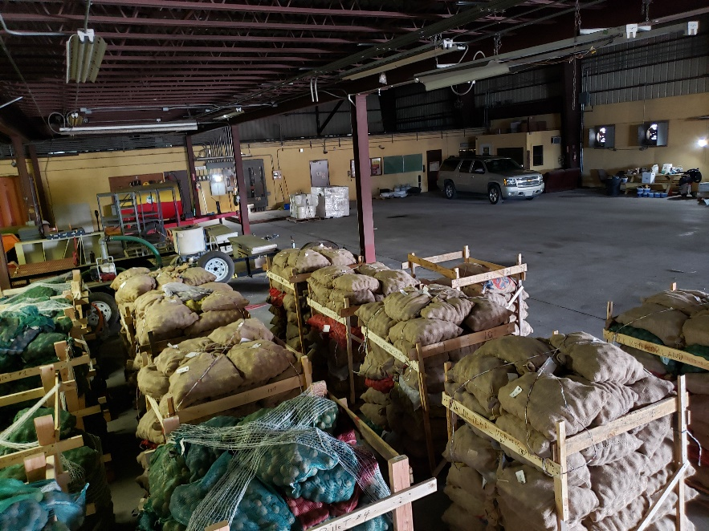
Sample Preparation
Samples received until Oct 23
  Normal harvest
  345 lots submitted
Warm climate (70°)
Gassed with Bromoethane
Shipped Oct 30
Notes:
Very little tuber rot in samples. Good maturity in field.

Slide 6
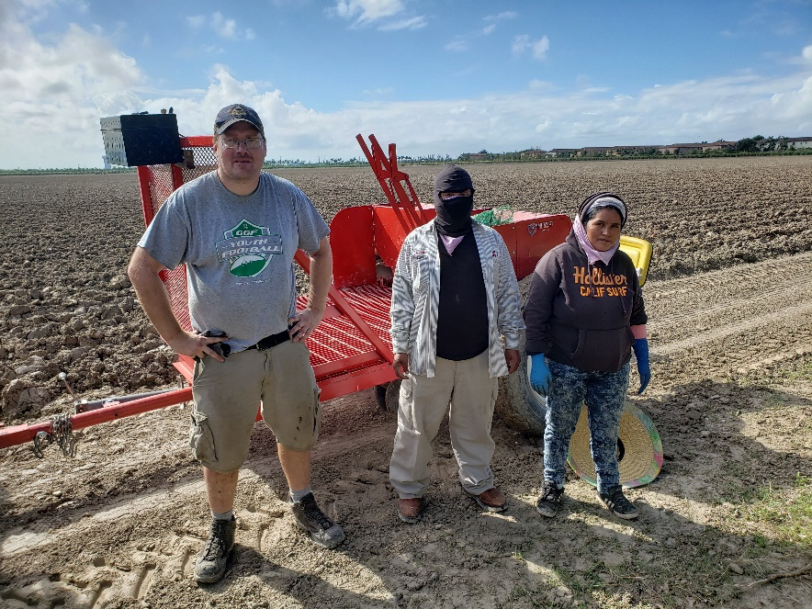

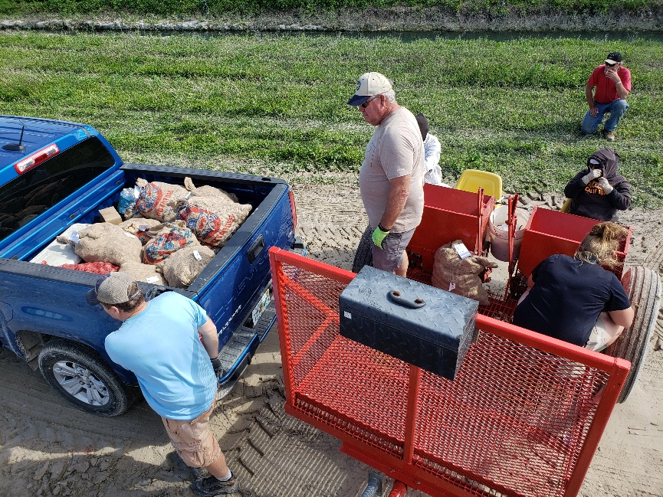
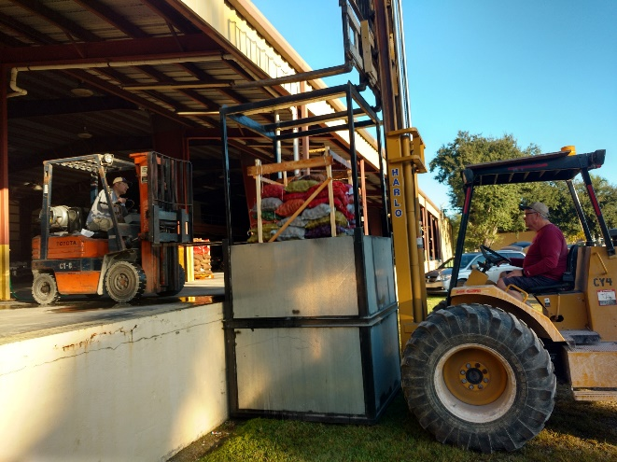
Planting
November 17 – 20
Gibberellic dipping tank
Wet planting conditions
Excellent support from Alger Farms
Notes:
Equipment was ready. Used the ‘New’ planter acquired from GF research farm
Soil conditions very wet.
Excellent support to move pallets from dock to field. (John Jr)
Extra help was very good. Same workers as past 4 years.
Great to have Mark Thompson helping again this year.
MN staff helped plant. We reciprocated and helped them plant.

Slide 7
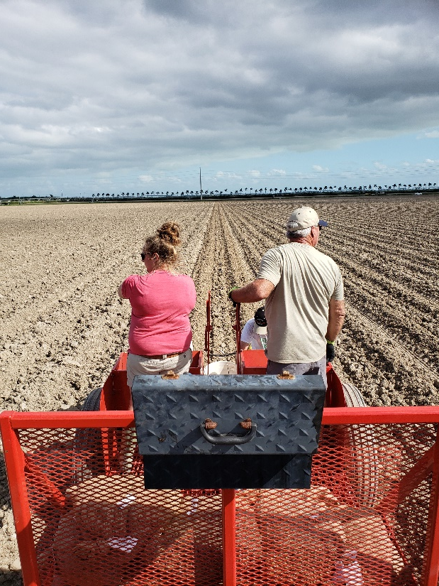
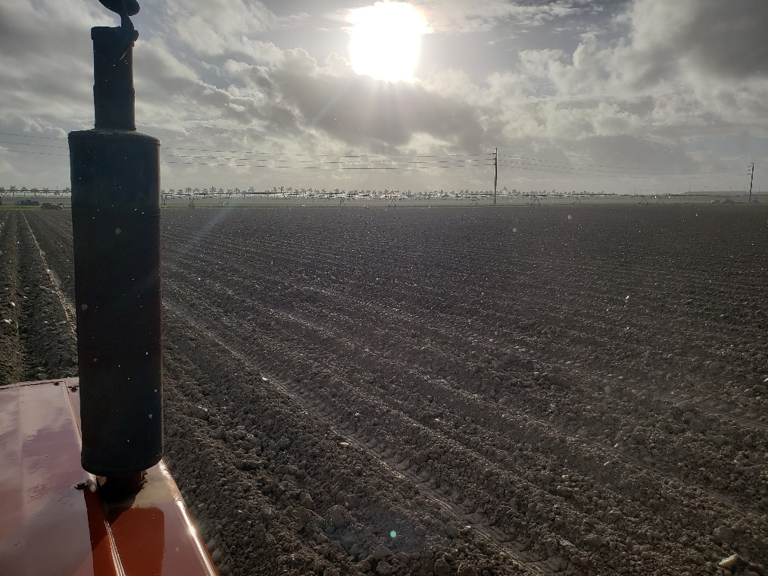
Fair Planting Weather – Wet Soil

Slide 8
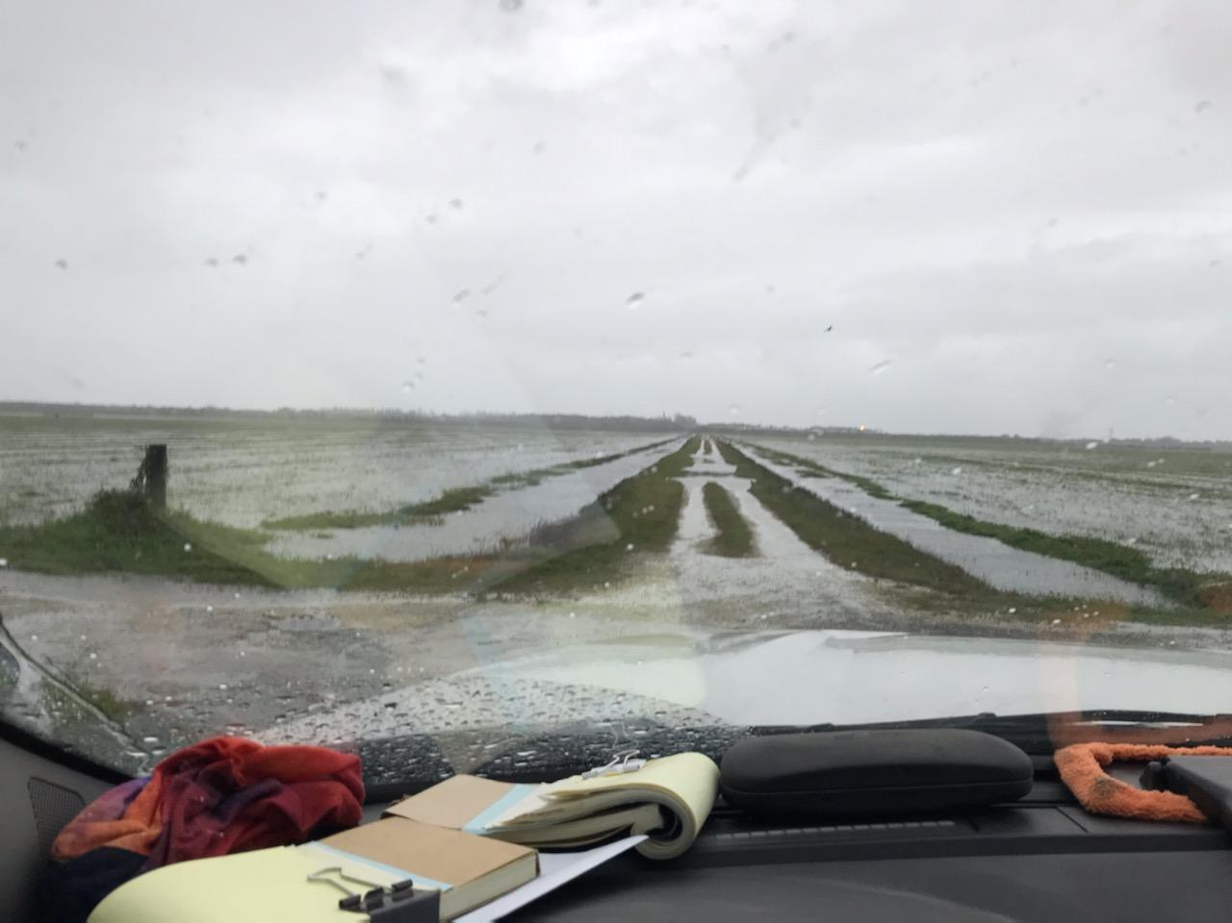
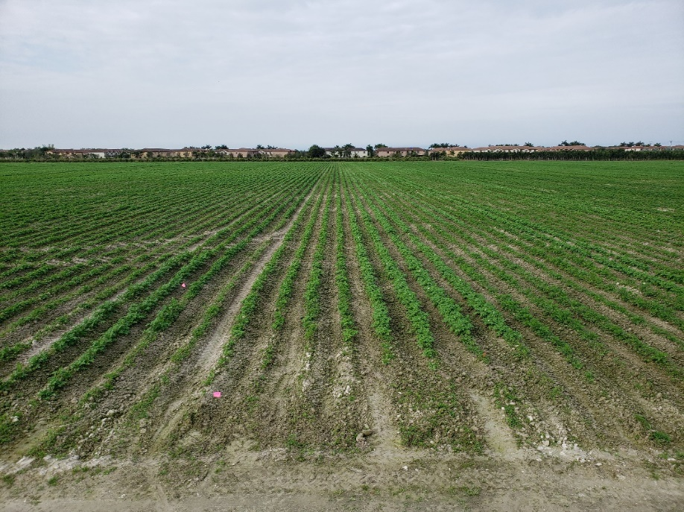
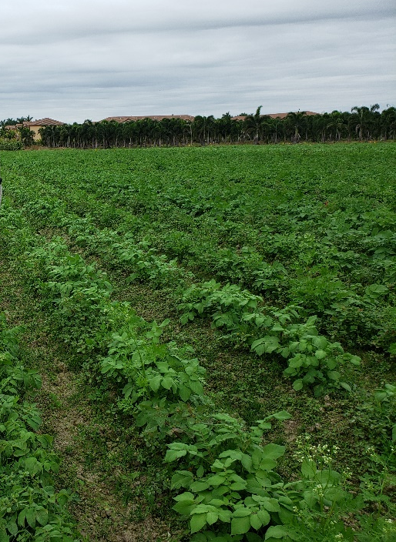
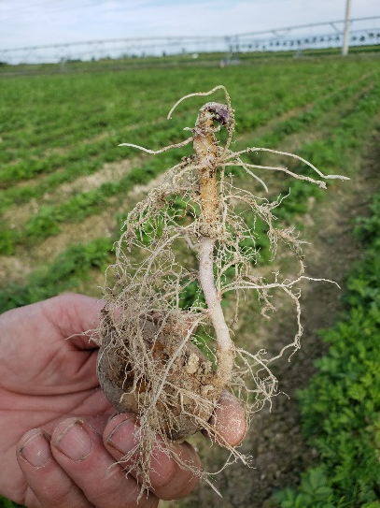
Wet planting Encrusted soil, decreased emergence
Rain events Less vigor, slower growth
Cold weather events Weeds
Tropical Storm Eta Nov 9
Jan 4
Dec 18
Jan 14
Notes:
Tough year.
Tropical Storm Eta blew through Nov 9.
Finally entered field for planting Nov 17.
Very wet
Rain Nov 21 after planting was done. 1.5 inches.
Cold weather events Dec 1-2, Dec 7-10 and Dec 25-27
Soil compaction on hill surface hindered emergence. Some sprouts from tubers could not push through.

Slide 9
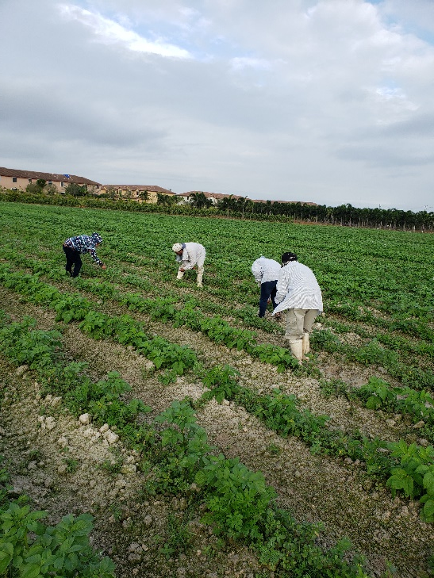
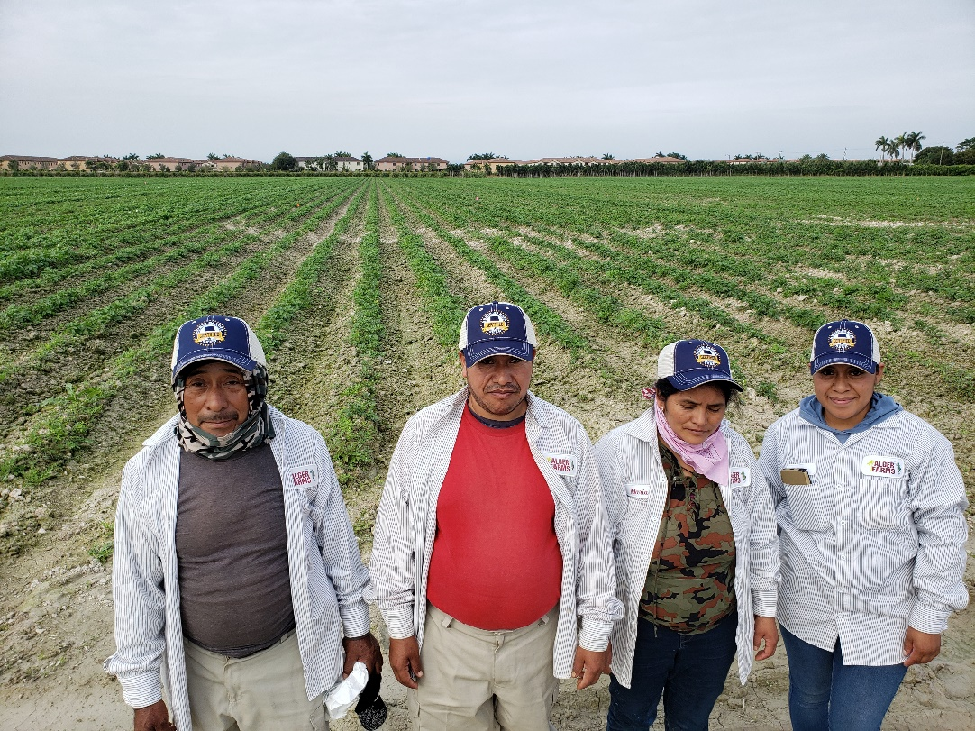
Leaf Picking/Testing
ELISA Leaf testing
Latent varieties (required)
Requested lots (ID, CO, self)
64 lots
  approx. 21,000 leaves
Notes:
Very similar in scope to 2019 crop.
same Alger employees that have helped over the past years

Slide 10
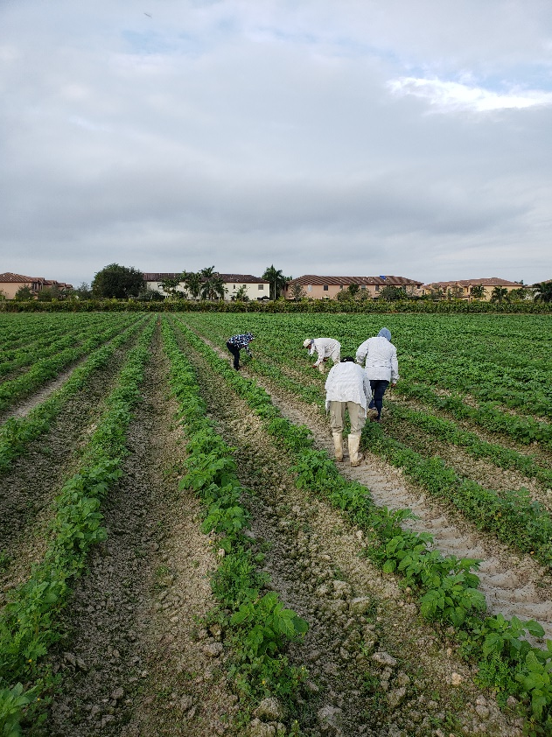
Leaf Testing (cont)
Picked Jan 3 and 4
Shipped Jan 4
Tested Jan 5, 6, and 7
Results aligned with visual readings
Notes:
Two days of picking.
Lab staff in Fargo scheduled and prepared to process.
Timing worked as well as possible. Had results by Jan 8.

Slide 11
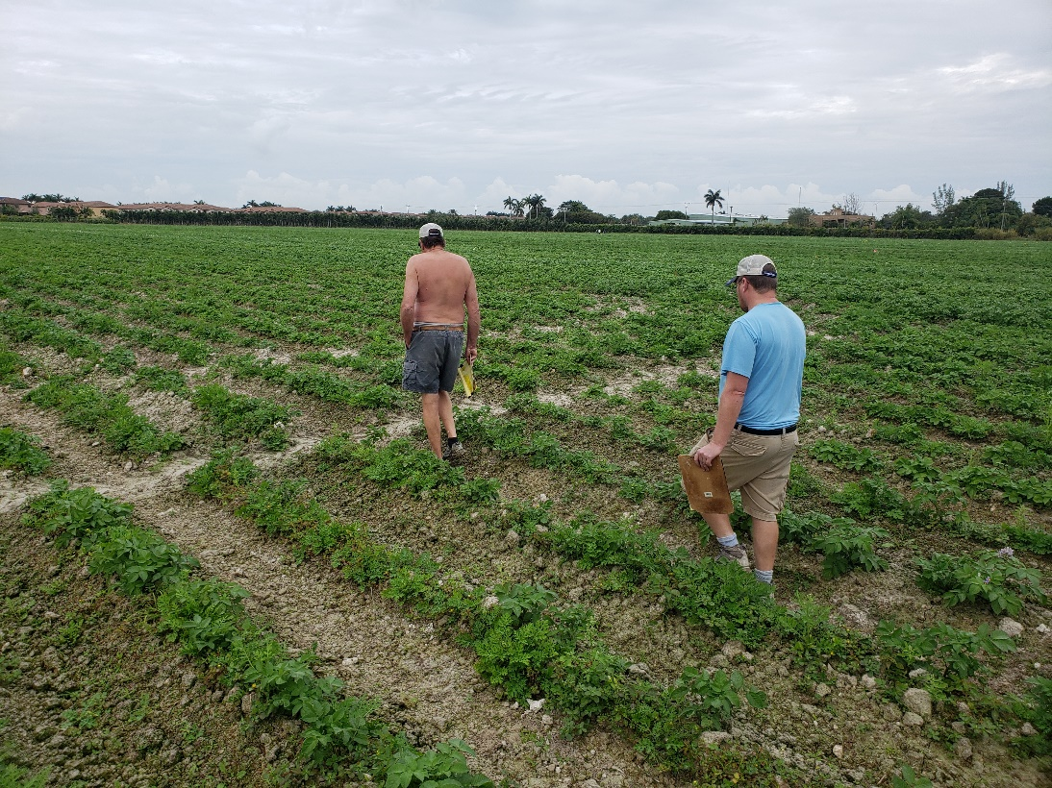
Inspections
Jan 3-16, 2021
Each plant/lot observed minimum of 6 times
  3 inspectors
  2 inspections
  Additional confirmations of PVY positive tested lots
Notes:
Very thorough.

Slide 12
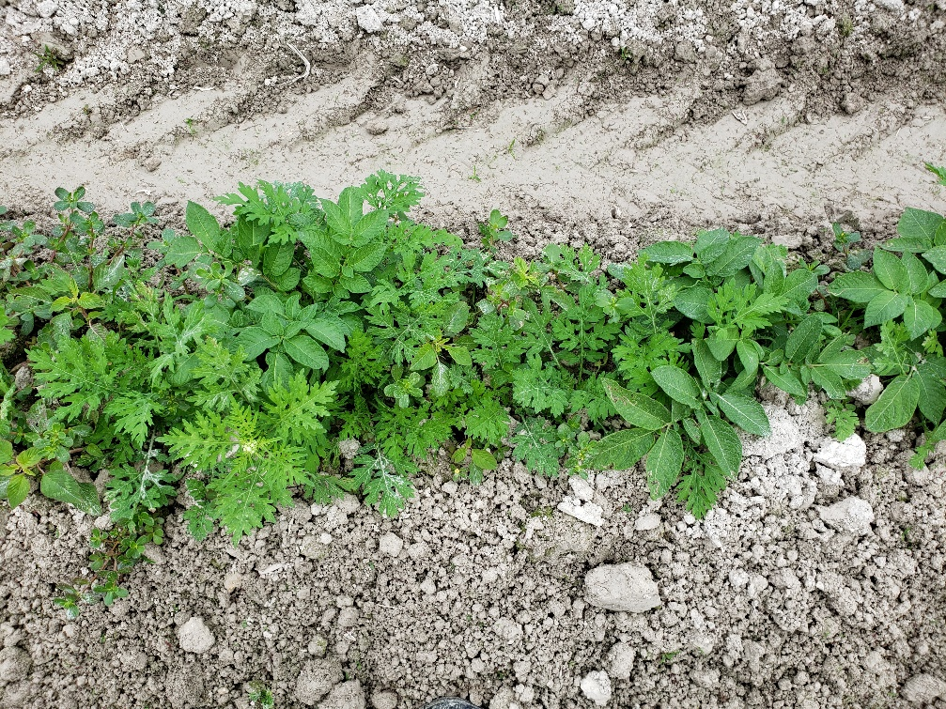
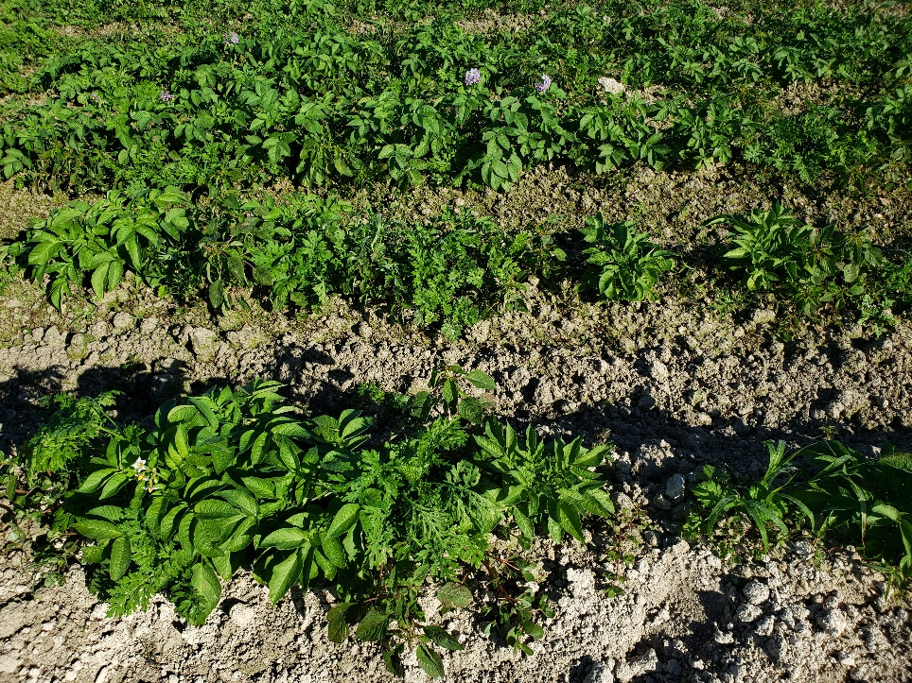
Weeds and Emergence
Notes:
As mentioned emergence was hampered by conditions.
Weeds established and were competitive

Slide 13
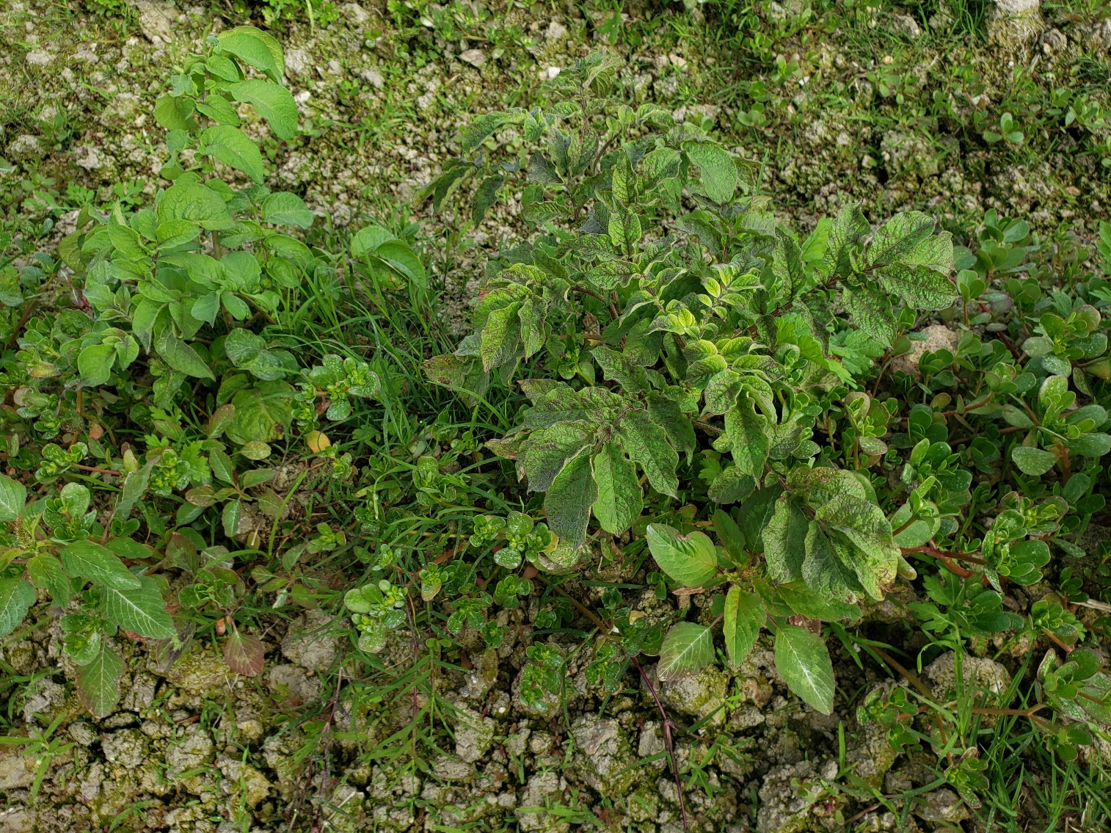
Notes:
Still had good symptom expression of virus

Slide 14
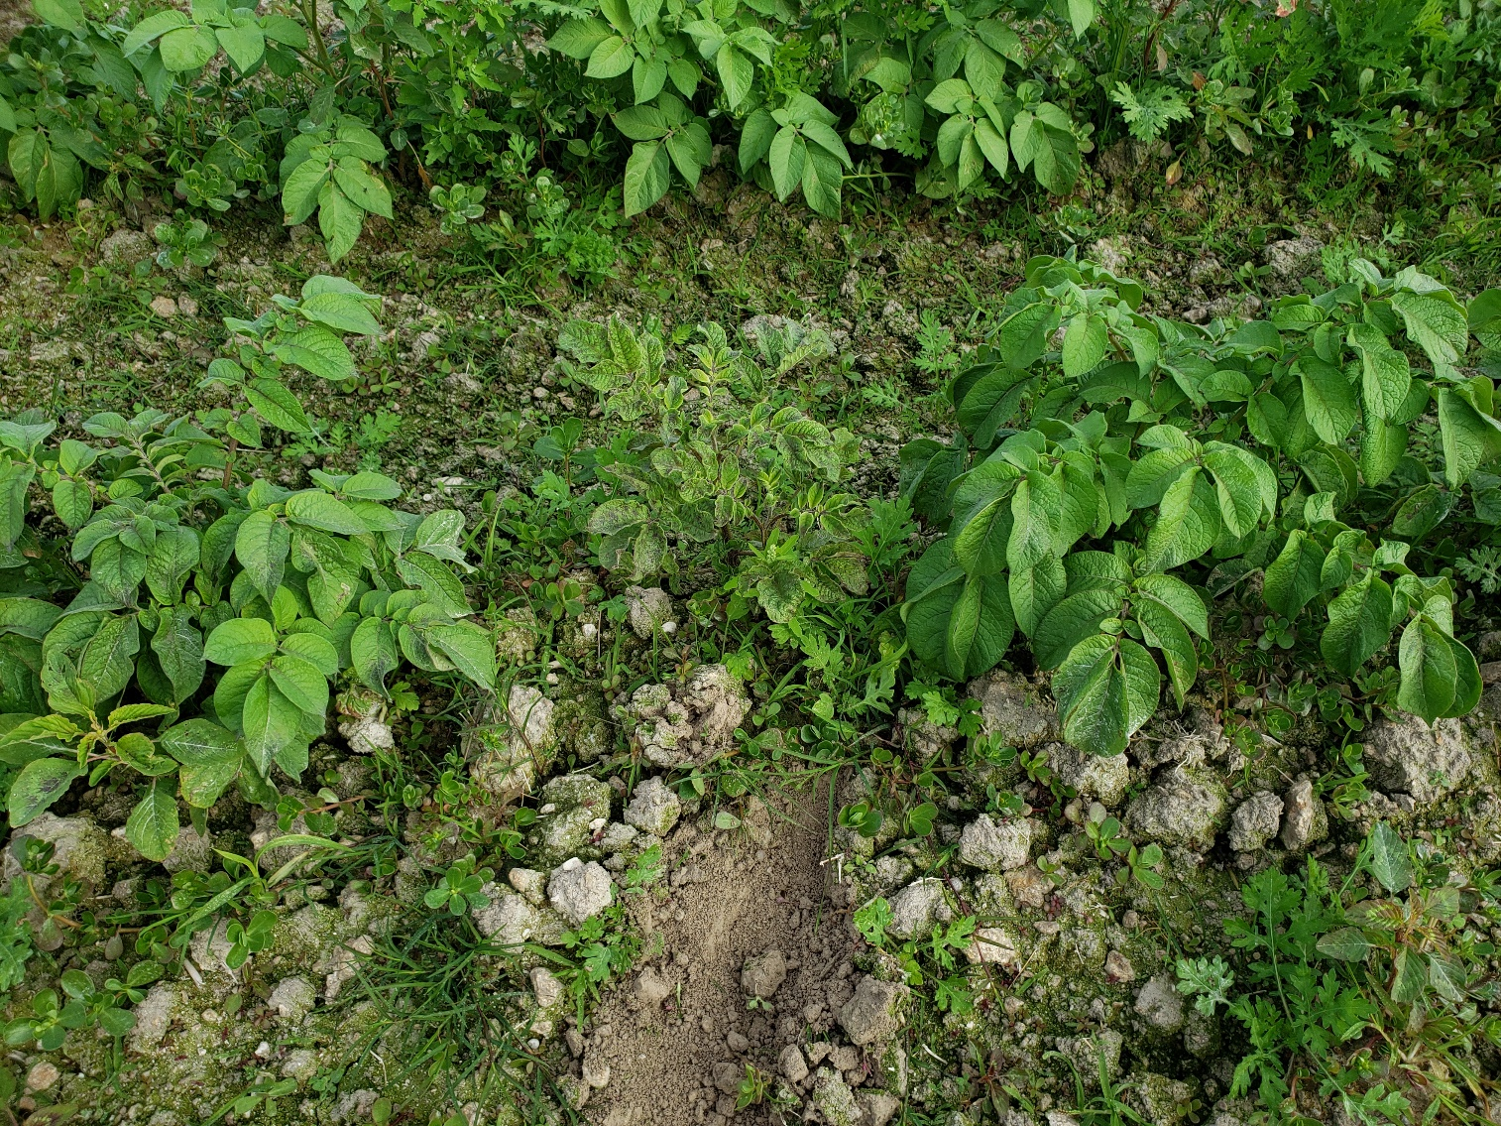
Notes:
Good symptom expression

Slide 15
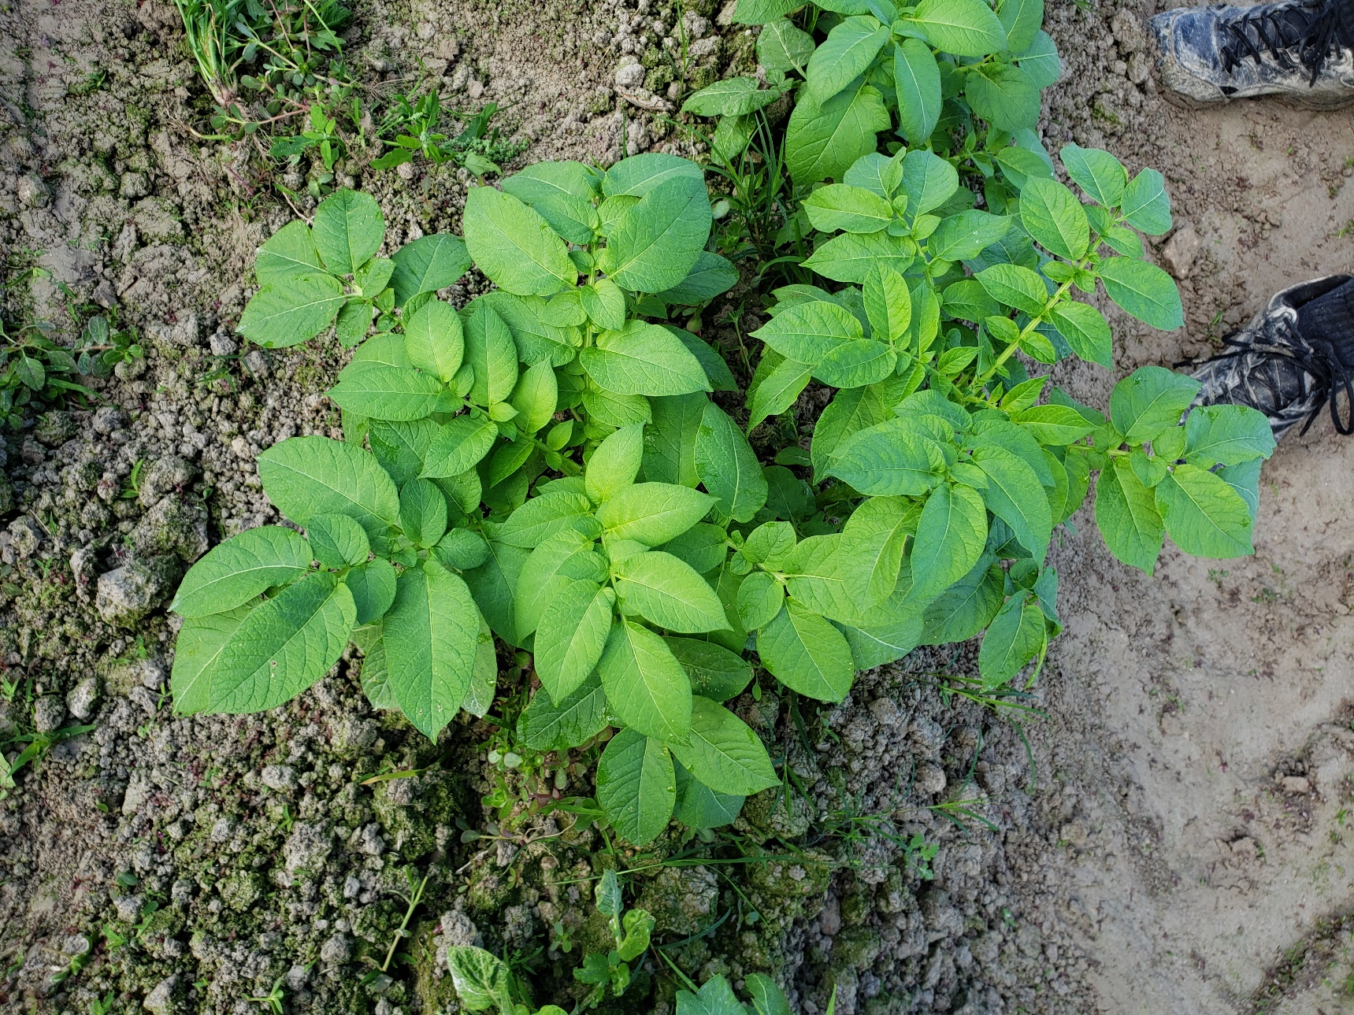
Notes:
Good symptom expression.
This tuber produced two stems. One was positive for PVY. One was negative (healthy)
Virus is not always equally distributed through the tuber. Some sprouts are infected and others may not be.
We found another example like this in another seed lot.

Slide 16
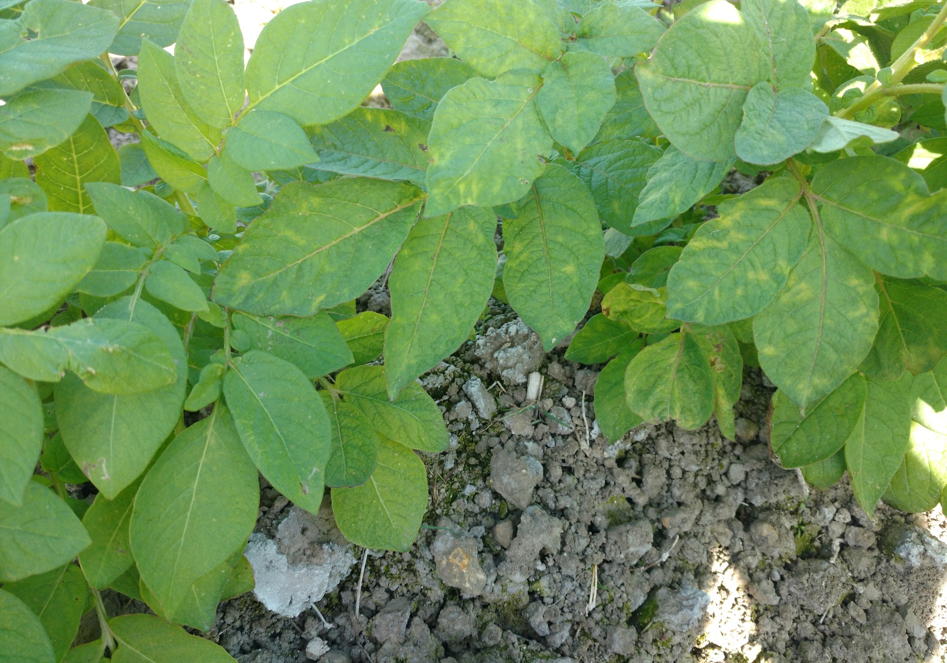
Notes:
Good symptom expression

Slide 17
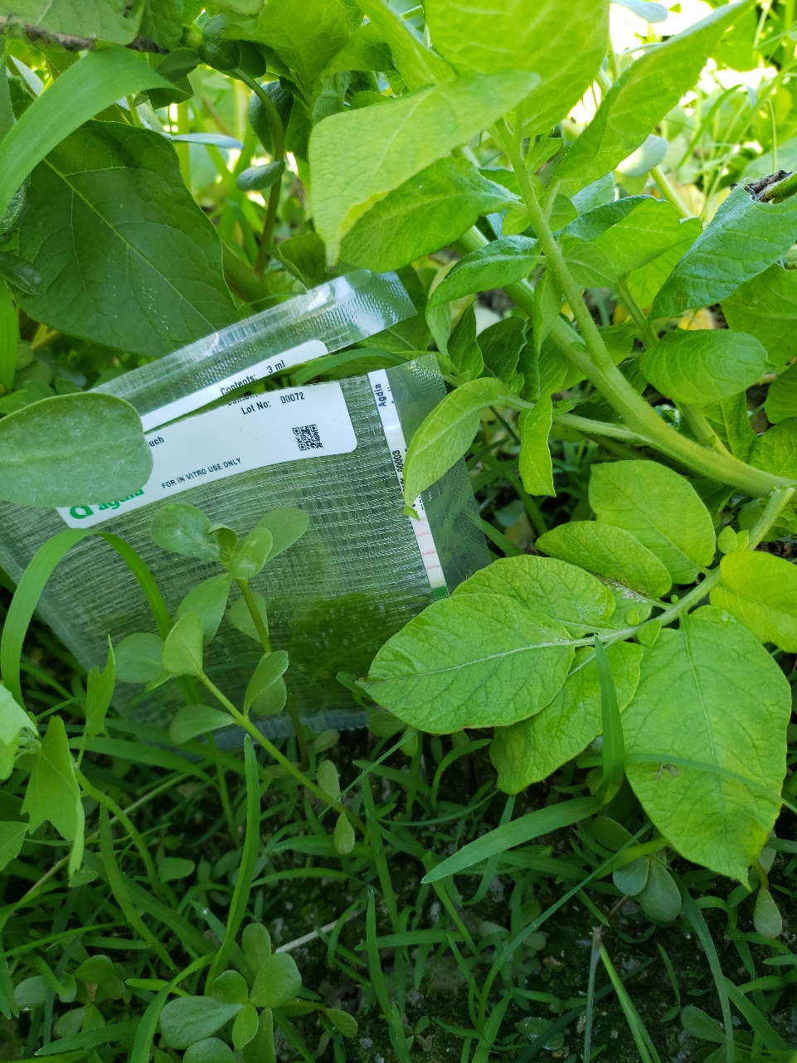
Immuno-strip Testing for PVY and PVY^{N}
Notes:
Used Agdia Immuno test strips for on-site confirmation of questionable plants.

Slide 18
Recertification Eligibility
345 Lots: 7,411 acres: 5,985 Eligible; 1,426 Ineligible
Notes:
Explain slides: (345 – 309): 36 lots more than 2019 crop. 528 acres more (7411 – 6883). 5985 Eligible (4057 elig 2019), 1426 Inel (2826 inel)
Biggest comparison to 2019 crop is that we had 1900 acres more eligible for recertification.
Vertical axes list acres
Horizontal is Field Year, sub headed by eligible and ineligible data
First line is acres ineligible related to Field Year
Second line is acres Eligible related to Field Year
Eligibility based on maximum of 0.5% Mosaic
Shows what would be expected…clean early Field Years, increasing mosaic levels later Field Years.
318 lots were eligible. 27 lots are ineligible for recertification.

Slide 19
Reds: 95 Lots; 2,031 Acres
1,686 Acres Eligible, 345 Acres Ineligible
Notes:
By potato type:
Eligibility in FY4 much higher than past years.
Last year (2019 crop) 81 lots, 1,667 acres: 540 Eligible, 1,127 ineligible
This year: 1000 acres more Eligible due to good harvest of summer acres and higher virus in harvested acres.
Similar to normal expected pattern

Slide 20
Russets: 118 Lots; 3,118 Acres
2,200 Acres Eligible, 918 Acres Ineligible
Notes:
Similar to normal expected pattern
Comparison: similar to last year.
2019 Crop: 101 lots, 3,052 acres, 2,149 eligible, 903 ineligible

Slide 21
Whites: 103 Lots; 1,963 Acres
1,844 Acres Eligible, 85 Acres Ineligible
Notes:
Expected results
Comparison : 600 more eligible acres than last year
2019 Crop: 97 lots, 1,963 total, 1,231 eligible, 732 inel

Slide 22
Specialties: 29 Lots; 333 Acres
255 Acres Eligible, 78 Acres Ineligible
Notes:
Limited acreage. Yellow flesh and other specialties
Comparison very similar to last year.
2019 30 lots, 200 acres; 135 eligible, 65 ineligible

Slide 23
Acres Eligible Comparison by Type
Notes:
Same eligible acres as previous slides
Across board comparison by type of potato.
Russets at back, reds, whites, sp

Slide 24
Notes:
Line graph is Acres submitted for Winter Test over recent years.
The top line is summer acreage that was accepted for certification.
green line is total acres represented by lots submitted to WT.
Red line is Eligible acres after WT plot inspection. Eligible is defined as less than 0.5% virus. Virus is Mosaic caused by PVY
Purple line is Ineligible acres after WT plot inspection. Greater than 0.5% virus.
Overall quality of our replant crop increases as the red line moves closer to the green line.
Growers made good decisions last year. They planted seed with zero or very low levels of Mosaic. They managed it well during the summer, and killed vines before virus could spread.

Slide 25
Notes:
Follow the 80% level on the graph.
5th best year in past 20 years.

Slide 26
Comparison over Years
Crop Year | Total Acres Represented | Eligible Acres | % Eligible Acres | Acres 0 PVY | % 0 PVY
2016 | 8,338 | 6,797 | 82 | 4,881 | 58
2017 | 8,000 | 5,711 | 71 | 3,721 | 47
2018 | 8,045 | 5,545 | 69 | 2,834 | 35
2019 | 6,883 | 4,055 | 59 | 1,704 | 25
2020 | 7,411 | 5,985 | 81 | 3,439 | 46
Notes:
Real story is in the last table.
Eligible means 0.5% mosaic or less.

Slide 27
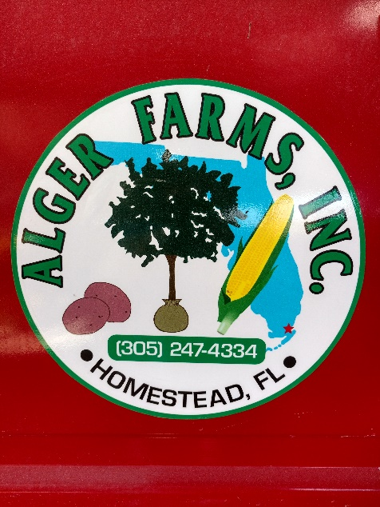
Cooperating Grower Review
Alger Farms, Inc
Excellent support during planting
Excellent staff support for leaf picking
Good soil fertility through inspection
Various pesticides
  Preplant herbicides (high moisture limited control)
  Bravo
  Insecticides

Slide 28
Comments and Results
Some stand issues caused by soil compaction, environment, wet, cool
Some poor dormancy break (FL 2204, 2395)
Slow vine growth, smaller plants
Weeds
Mosaic symptoms good
Inspections good but slower
No evidence of current season or ‘top infection’ of PVY
No obvious symptoms of Blackleg/Dickeya
81% of acres submitted passed Eligibility requirements
Notes:
Stand and growth due to normal physiology of tubers? Normal growth, decent growing conditions?
79% eligible acres up from 59% last year,
Health Certificates – Full transparency

Slide 29
Results and Comments
81% of acres submitted passed Recertification Eligibility requirements (0.5% or less Mosaic)
Field Isolation works
Spread happens
Estimate only
No BL, no Dickeya
North American Health Certificates
  request them
  provide them
Notes:
81% is eligible seed for recertificaiton.
Estimate
Health Certificates – Full transparency lists data specific to seed lots.
Required for seed leaving the state for recertification.
Required for lots coming into the state for recertification.

Slide 30
Interpretation/Management
Flush lots with higher readings
Careful consideration about replanting ineligible lots
  Inoculum source for area
  Permission from Seed Dept required prior to planting
Isolation
Planting/vine kill dates
Early vine kill limits spread

Slide 31
Interpretation/Management (cont.)
Know your market. Additional testing for out of state buyers may be necessary.
North American Health Certificates–
  use them
  provide them
  request them from other growers
  necessary for seed from out of state
Transparency
Notes:
Health Certificates = Transparency
When effort is made to be transparent, reduces product liability.

Slide 32

Questions
Discussion
Notes:
Thanks and acknowledgement to all Seed Dept staff:
Inspectors Help with handling samples
Planting
Inspecting
Especially Mikes leadership during the process.
Willem answered a few questions too!
Lab crew: Sue, Dylan, Brianna, Hilary April for quick clean turn-around with testing results from plots.
Kris and Deb for general support, and for making a huge effort in recent days to process results into the computer, and generate Approved Seed List and NAHC. Kris for work on the new computer system, streamlining data entry and disbursement.
And to Ken for discussions and guidance about the general process.

Slide 33


Slide 34
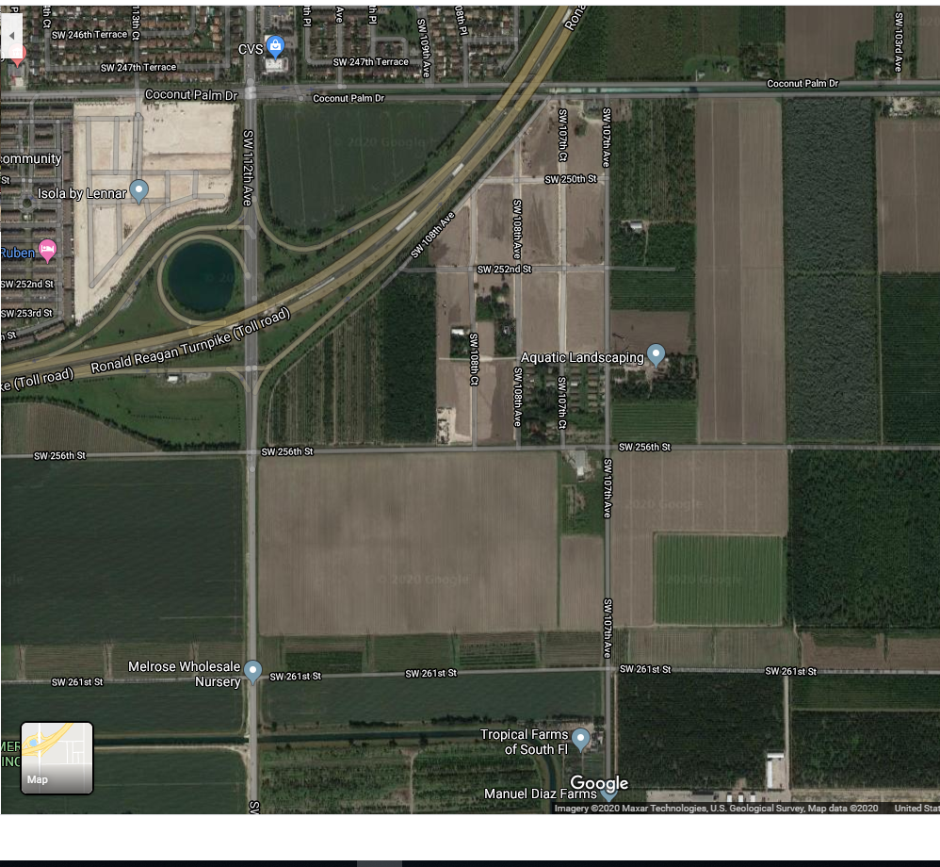
Development North West of land owned by NDCSPGA

Slide 35
Summary
Unbiased random sample drawn evenly across acres
Estimate only
Spread happens
Critique of process

